Slide 1
Clause Classification
Yogesh Kulkarni

Slide 2
Agenda
Introduction
Text Classification
Clause Classification
Dataset
Vectorization
Classification
Metrics
Day 2

Slide 3
Introduction to Text Classification

Slide 4
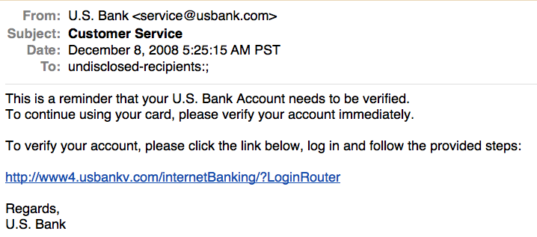
Is this spam?
(Ref: Text Classification - The Naïve Bayes algorithm)

Slide 5


Positive or negative movie review?
unbelievably disappointing
Full of zany characters and richly applied satire, and some great plot twists
this is the greatest screwball comedy ever filmed
It was pathetic. The worst part about it was the boxing scenes.
(Ref: Text Classification - The Naïve Bayes algorithm)

Slide 6
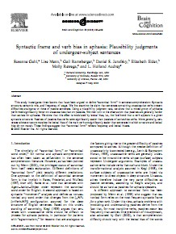
What is the subject of this article?
MEDLINE Article
MeSH Subject Category Hierarchy
Antogonists and Inhibitors
Blood Supply
Chemistry
Drug Therapy
Embryology
Epidemiology
…
?
(Ref: Text Classification - The Naïve Bayes algorithm)

Slide 7
Introduction to Clause Classification

Slide 8
What is a Contract?
A legally binding agreement between two or more persons which the courts will enforce
Generates rights and obligations that may be enforced by courts
Agreement arises as a result of offer and acceptance

Slide 9
Requirements for a valid contract
Parties must have legal capacity to enter contracts
One party must make a binding offer to the other, and the offer must be accepted by the other party
Consideration
Agreement must be genuine
In some cases, the contract must be made in a particular form
The object of the contract must not be disapproved by the law
In summary, need:
Offer
Acceptance
Consideration - An exchange of promises to perform acts in the future

Slide 10
Contents of the contract
Terms - Conditions or duties which must be carried out as part of a contract, arrangemens which must be made before a contract is valid
Express terms: Terms that the parties have specifically agreed to
Implied terms: e.g., goods are of satisfactory quality and are fit for their purpose
Conditions: If a party does not carry it out, you not only have the right to claim damages, but also to treat the contract as terminated
Warranties: If you have not carried out your obligations under a warranty, the other party has the right to sue you for damages, but not to terminate the contract
Exclusion terms
Termination:
Performance
Express agreement
Breach
Text/Language used to describe the Term is called “Clauses”.

Slide 11
What are clauses?
All the provisions for a contract are detailed in clauses: who gets paid, who does the work, and what happens if one party backs out of the contract.
Clauses are specific provisions or sections in your contract that address a specific aspect of the agreement.
Clauses clearly define each party’s duties, rights, and privileges under the terms of the contract.

Slide 12
Example Clauses: Exemptions
Exemption clause is a provision in a contract that limits the liability of one party.
Exemption types:
Exclusion: stipulates that one of the parties will not be liable to the other in certain specified situations or circumstances. For example, an exclusion clause in a life insurance contract may state that a death by suicide is excluded.
Indemnity: one party agrees to indemnify, or answer for, liability or losses incurred by another party.
Force Majeure (French: “Superior Forces”): Exempts the parties from liability if they are prevented from performing their contractual obligations by unforeseeable circumstances beyond their control.

Slide 13
Example Clauses
Escalation clause is a provision in a contract that allows for one party to increase the contracted-for prices or wages under certain specified conditions.
Penalty clause in a contract is a provision that requires a party that has not fulfilled its contractual obligations to pay specified compensation to the other party for the breach.
Confidentiality clauses bar the receiving party from disclosing the information specified except under certain specified circumstances.

Slide 14
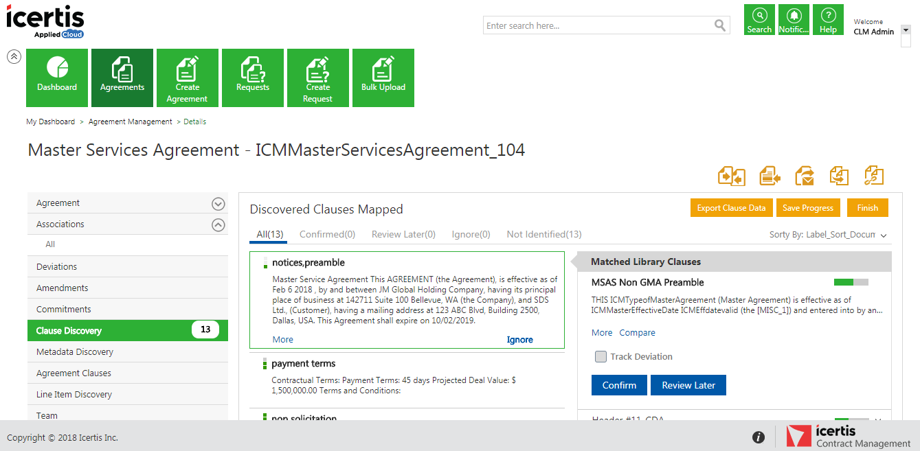
ICM DiscoverAI App
AI Powered NLP & Semantics Driven Clause Discovery, Deviations and Verifications
Powerful capabilities:
Image/PDF Conversion
Clause and Attribute Discovery
Accurate Clause Matching
Deviation Tracking
Attribute Verification
Driven by NLP & Machine Learning

Slide 15
Clause Discovery Flow and Applications
Corpus
Segmentation
Vectorization
Classification
Similarity
Obligations
Attributes

Slide 16
Dataset

Slide 17
Corpus Diversity
Distribution by function
Sales
Procurement
Corporate
Other
Distribution by Sector
Pharma
Manufacturing
Retail
Hi-tech
IT Services
Other
Distribution by Region
EMEA
APAC
NA
LATAM
Distribution by Complexity
# of pages
10-20
20-50
50-100
100-300
Doc type
docx
pdf
image pdf
Scan quality
300+
< 75 dpi
75-100 dpi
100-150 dpi
150-300 dpi
Notes:
#Contains tables
#language

Slide 18
Vectorization

Slide 19
Why Vectorize?
Text processing with current NNs requires encoding into vectors.
Prior work:
Learning representations by back-propagating errors. (Rumelhart et al., 1986)
A neural probabilistic language model (Bengio et al., 2003)
NLP (almost) from Scratch (Collobert & Weston, 2008)
A recent, even simpler and faster model: word2vec (Mikolov et al. 2013)
http://colah.github.io/posts/2014-07-NLP-RNNs-Representations/

Slide 20
Approaches
One-hot encoding (Word):
N words encoded by length N vectors.
A word gets a vector with exactly one entry = 1, others 0.
Very space inefficient, no natural language structure.
Bag of words (doc):
Collection of words (along with number of occurrences).
No word order, no natural language structure.
Tf-Idf (doc)
Less sparse
No word order but unique words have more weights.
Word Embeddings (word, doc):
Predict words using context
Considers order

Slide 21
Word embeddings: properties
Need to have a function W(word) that returns a vector encoding that word.
Similarity of words corresponds to nearby vectors.
Director – chairman, scratched – scraped
Relationships between words correspond to difference between vectors.
Big – bigger, small – smaller

Slide 22
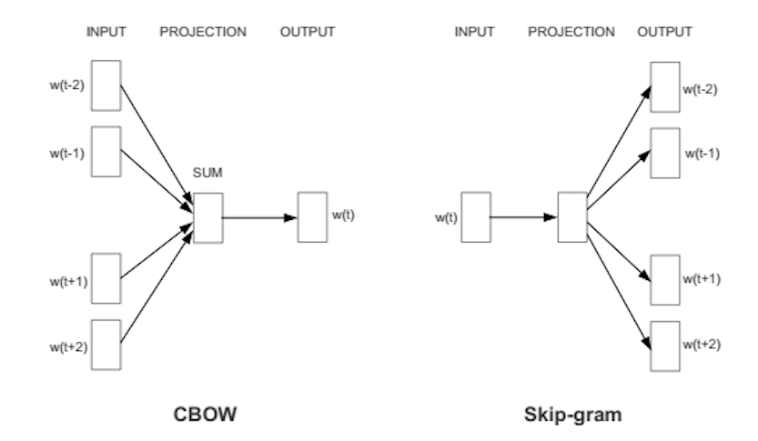
word2vec
Predict words using context
Two versions: CBOW (continuous bag of words) and Skip-gram
https://skymind.ai/wiki/word2vec

Slide 23
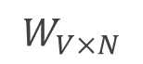
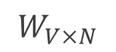
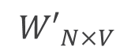
We must learn W and W’
Input layer
0
1
0
cat
0
$$W_{V×N}$$
Hidden layer
Output layer
0
0
0
0
0
0
V-dim
…
0
0
$${W′}_{N×V}$$
0
0
sat
0
0
0
0
1
0
$$W_{V×N}$$
N-dim
…
V-dim
1
0
on
0
0
0
0
V-dim
…
N will be the size of word vector
0
www.cs.ucr.edu/~vagelis/classes/CS242/slides/word2vec.pptx

Slide 24
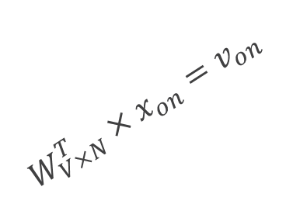
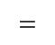
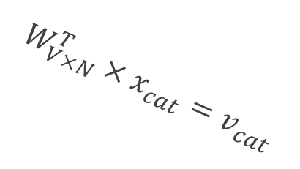
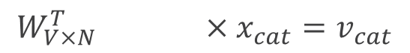
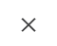
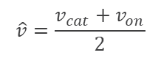
$$W_{V×N}^{T} ×x_{cat}=v_{cat}$$
0.1 | 2.4 | 1.6 | 1.8 | 0.5 | 0.9 | … | … | … | 3.2
0.5 | 2.6 | 1.4 | 2.9 | 1.5 | 3.6 | … | … | … | 6.1
… | … | … | … | … | … | … | … | … | …
… | … | … | … | … | … | … | … | … | …
0.6 | 1.8 | 2.7 | 1.9 | 2.4 | 2.0 | … | … | … | 1.2
0
2.4
2.6
…
…
1.8
Input layer
1
$$×$$
0
$$=$$
0
0
1
0
0
0
x_{cat}
0
0
Output layer
0
0
0
$$W_{V×N}^{T}×x_{cat}=v_{cat}$$
…
0
0
0
0
0
V-dim
…
0
0
$$\hat{v}=\frac{v_{cat}+v_{on}}{2}$$
0
+
0
sat
0
0
0
0
$$W_{V×N}^{T}×x_{on}=v_{on}$$
1
0
…
V-dim
1
Hidden layer
0
x_{on}
0
0
N-dim
0
0
V-dim
…
0
www.cs.ucr.edu/~vagelis/classes/CS242/slides/word2vec.pptx

Slide 25



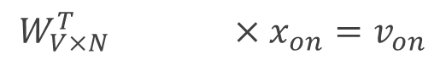
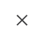
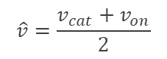
$$W_{V×N}^{T} ×x_{on}=v_{on}$$
0.1 | 2.4 | 1.6 | 1.8 | 0.5 | 0.9 | … | … | … | 3.2
0.5 | 2.6 | 1.4 | 2.9 | 1.5 | 3.6 | … | … | … | 6.1
… | … | … | … | … | … | … | … | … | …
… | … | … | … | … | … | … | … | … | …
0.6 | 1.8 | 2.7 | 1.9 | 2.4 | 2.0 | … | … | … | 1.2
0
1.8
2.9
…
…
1.9
Input layer
0
$$×$$
0
$$=$$
0
1
1
0
0
0
x_{cat}
0
0
Output layer
0
0
0
$$W_{V×N}^{T}×x_{cat}=v_{cat}$$
…
0
0
0
0
0
V-dim
…
0
0
$$\hat{v}=\frac{v_{cat}+v_{on}}{2}$$
0
+
0
sat
0
0
0
0
$$W_{V×N}^{T}×x_{on}=v_{on}$$
1
0
…
V-dim
1
Hidden layer
0
x_{on}
0
0
N-dim
0
0
V-dim
…
0
www.cs.ucr.edu/~vagelis/classes/CS242/slides/word2vec.pptx

Slide 26
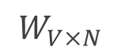
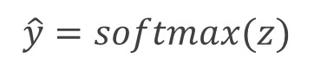
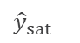
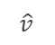
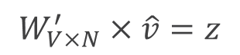
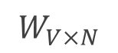
Input layer
0
1
0
cat
0
$$W_{V×N}$$
Hidden layer
Output layer
0
0
0
0
0
0
V-dim
…
0
0
$$W_{V×N}^{′}×\hat{v}=z$$
0
$$\hat{y}=softmax(z)$$
0
0
0
0
0
$$\hat{v}$$
1
0
$$W_{V×N}$$
…
1
N-dim
0
on
0
${\hat{y}}_{sat}$
0
0
V-dim
0
V-dim
…
N will be the size of word vector
0
www.cs.ucr.edu/~vagelis/classes/CS242/slides/word2vec.pptx

Slide 27
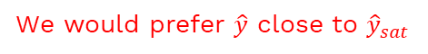
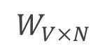
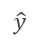
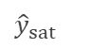
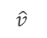
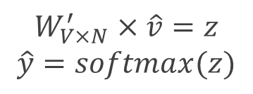
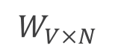
Input layer
0
We would prefer $\hat{y}$ close to ${\hat{y}}_{sat}$
1
0
cat
0
$$W_{V×N}$$
Hidden layer
Output layer
0
0
0
0
0.01
0.02
0.00
0.02
0.01
0.02
0.01
0.7
…
0.00
0
0
V-dim
…
0
0
$$W_{V×N}^{′}×\hat{v}=z$$
$$\hat{y}=softmax(z)$$
0
0
0
0
0
0
$$\hat{v}$$
1
0
$$W_{V×N}$$
…
1
N-dim
0
on
0
${\hat{y}}_{sat}$
0
0
V-dim
0
V-dim
…
N will be the size of word vector
$\hat{y}$
0
www.cs.ucr.edu/~vagelis/classes/CS242/slides/word2vec.pptx

Slide 28
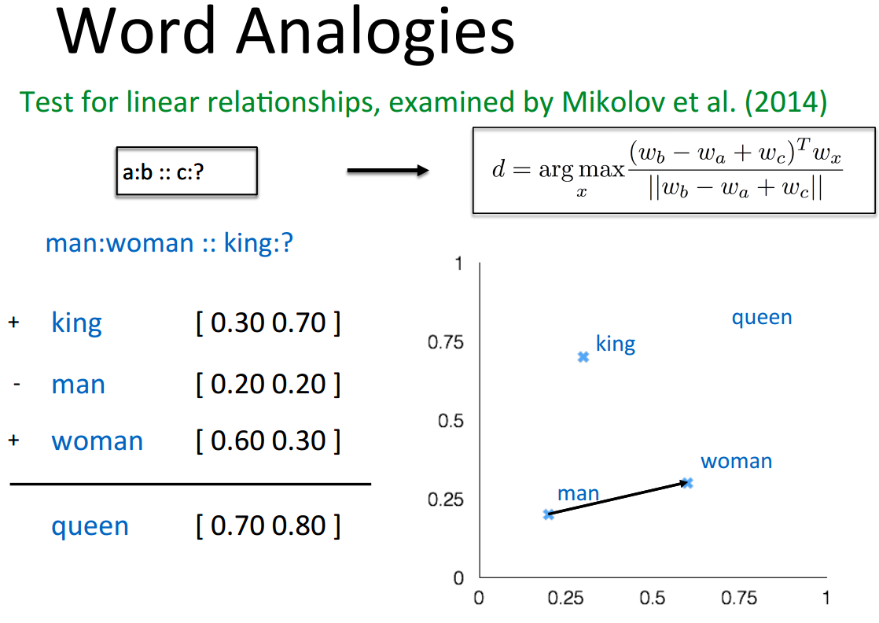
Some interesting results
www.cs.ucr.edu/~vagelis/classes/CS242/slides/word2vec.pptx

Slide 29
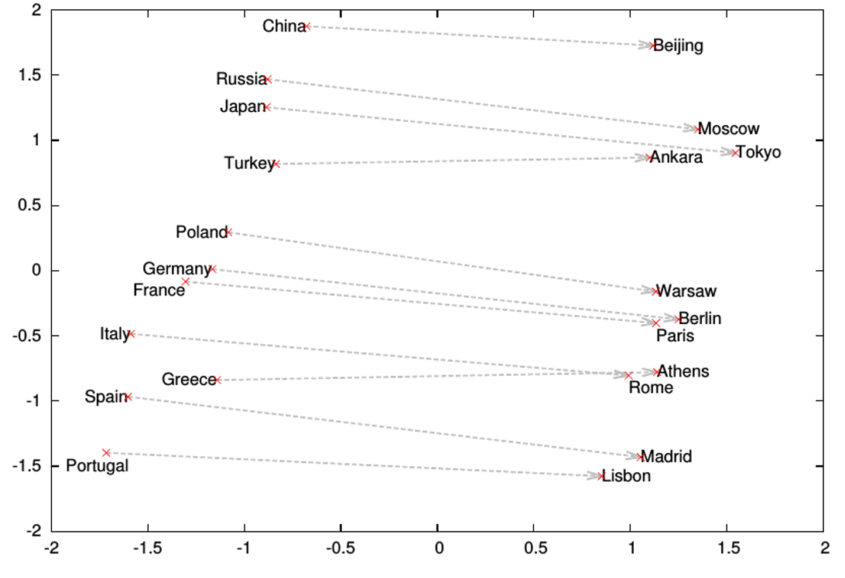
Word analogies
www.cs.ucr.edu/~vagelis/classes/CS242/slides/word2vec.pptx

Slide 30
Skip gram/CBOW intuition
Similar “contexts” (that is, what words are likely to appear around them), lead to similar embeddings for two words.
One way for the network to output similar context predictions for these two words is if the word vectors are similar. So, if two words have similar contexts, then the network is motivated to learn similar word vectors for these two words!
http://mccormickml.com/2016/04/19/word2vec-tutorial-the-skip-gram-model/

Slide 31
Word2vec shortcomings
Problem: 10,000 words and 300 dim embedding gives a large parameter space to learn. And 10K words is minimal for real applications.
Slow to train, and need lots of data, particularly to learn uncommon words.

Slide 32
Classification

Slide 33
Classification methods: 1. Manual
Manual classification was used by Yahoo in the beginning of the web. Also: ODP, PubMed
Very accurate if job is done by experts
Consistent when the problem size and team is small
Scaling manual classification is difficult and expensive.
→ We need automatic methods for classification.
33

Slide 34
Classification methods: 2. Rule-based
Our Google Alerts example was rule-based classification.
There are IDE-type development environments for writing very complex rules efficiently. (e.g., Verity)
Often: Boolean combinations (as in Google Alerts)
Accuracy is very high if a rule has been carefully refined over time by a subject expert.
Building and maintaining rule-based classification systems is cumbersome and expensive.
34

Slide 35
Classification methods: 3. Supervised Machine Learning
Input:
a document d ∈ D
a fixed set of classes C = {c1, c2,…, cK}
A training set of N hand-labeled documents T = { (d1,c1),....,(dN,cN) }
Output:
a learned classifier γ: D → C
Naive Bayes, kNN, SVMs
No free lunch: requires hand-classified training data

Slide 36
Metrics

Slide 37
Evaluating classification
Evaluation must be done on test data that are independent of the training data (usually a disjoint set of instances).
It’s easy to get good performance on a test set that was available to the learner during training (e.g., just memorize the test set).
Measures: Precision, recall, F1, classification accuracy
37

Slide 38
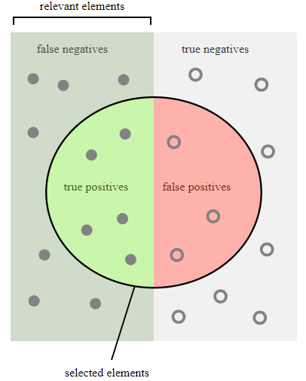
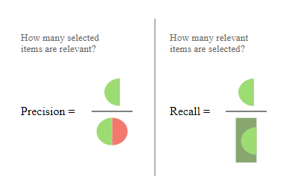
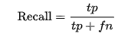
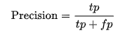
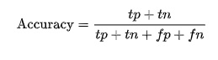
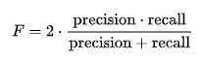
Recap: Accuracy Measurements
Actual elements
Recall – Measure of coverage
How many actual elements are selected
Precision – Measure of correctness
How many selected elements are correct
Accuracy – Most intuitive parameter of effectiveness but fails when dataset is not balanced
F1 score – the balancing act
Measure to check effective of model without being biased towards precision or recall

Slide 39
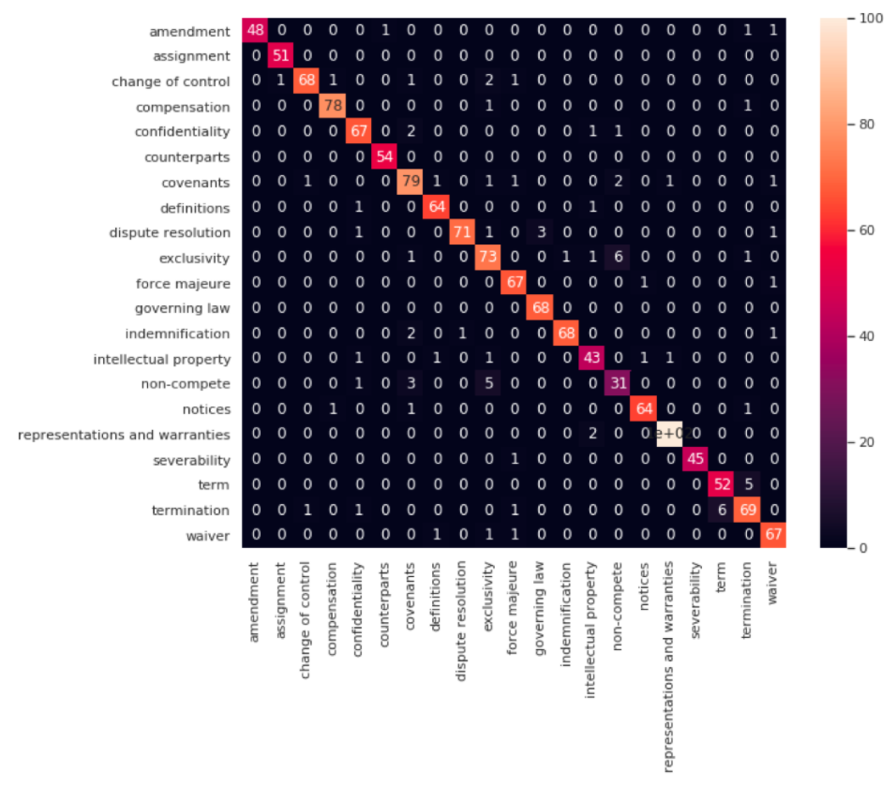
Confusion Matrix
39

Slide 40
Next steps
You can get soft copies of Reference materials/this ppt
Apply at least a few concepts/Techniques
Questions?

Slide 41
Thank You

